Slide 1


Slide 2


Slide 3


Go For The Goal!
Introductory Level

Slide 4




What do these images have in common?

Slide 5
For instance, a person could seek a career or financial goal
A goal is something a person intends to accomplish

Slide 6

Would you drive to the other side of the country?
Mapping Out Goals
Would you do it with or without a map or smart device?

Slide 7

Why Set Goals?
Setting goals is like using a road map to find a route to reach your goal(s)
  Provides direction
  Focuses on the important things
  Uses resources wisely
  Keeps the end result in mind

Slide 8
Types of Goals
Short-Term –
one year or less
Improving grades at school
Making the basketball team
Saving money to buy a new phone
Long-Term – more than one year
Attending college
Getting a great job
Buying a new car

Slide 9
Short-Term or Long-Term?
In your small group, read your scenario card.
Discuss with your group if this is a Short-Term or Long-Term Goal
Have 1 group member walk to the Short-Term Goal or Long-Term Goal sign. They will read aloud your group’s scenario and explain your decision.

Slide 10
What’s a SMART Goal?
S
M
A
R
T
Specific
Measurable
Attainable
Realistic
Time Bound
State exactly what is to be done
Include how the goal can be measured
Determine steps to reach the goal
Do not set goals for something unrealistic
State when the goal will be met
Now work together to write a Team SMART Goal on your Note Taking Guide

Slide 11
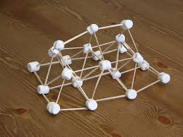
Team Goal Challenge!
Create a free- standing tower using your supplies
Before you build, work as a team and write down an engineering GOAL
Ready – Set – Create

Slide 12
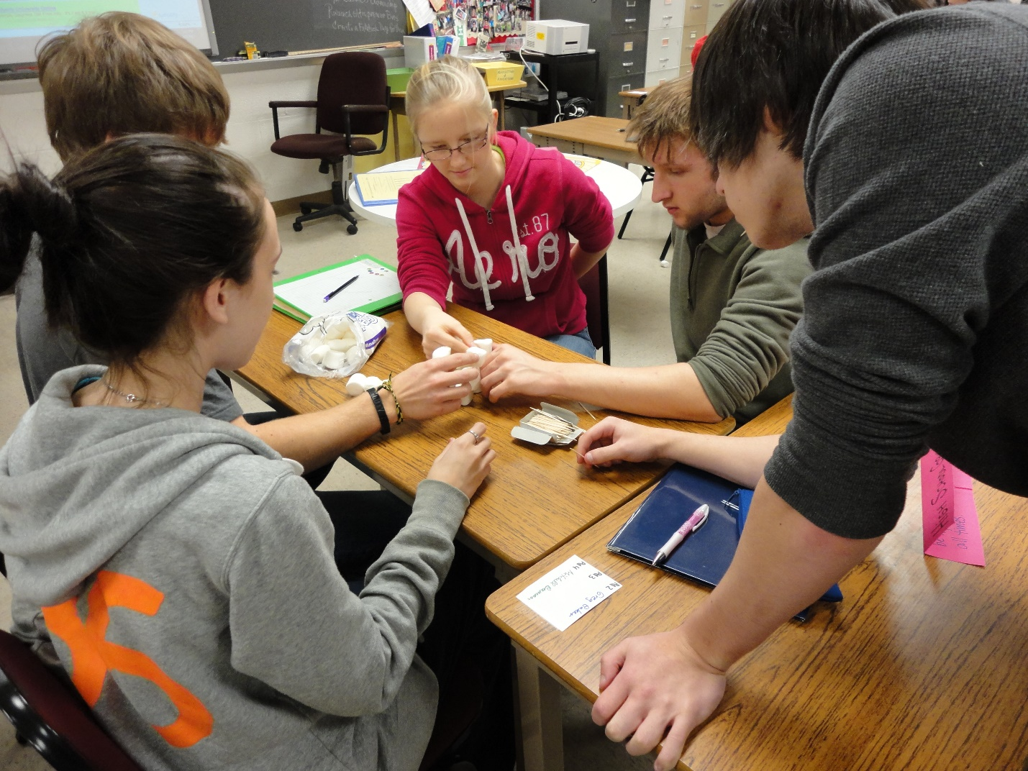
Time to Create Your Tower

Slide 13
Did You Reach Your Team Goal?
Was your goal specific?
How did you measure if you reached your goal?
Was your goal attainable or possible?
Was your goal realistic?
How much time did you set aside to achieve your goal?

Slide 14
Short- & Long-Term
Education Goals
Earning an A on a Quiz
College or Tech School
Honors Classes
Clubs & Sports
Online courses
Short & Long Term

Slide 15
Education Goals
Help individuals prepare for success in the workplace
What are two other ways educational goals help with financial success?

Slide 16
I want to go to
A Technical College
S
M
A
R
T
Specific
Measurable
Attainable
Realistic
Time Bound
I want to attend a two- year computer programming college.
Because I want to attend a two- year computer programming college, I will earn a B or higher in algebra.
Because I want to attend a two year computer programming college, I will earn a B in algebra this semester by studying for one hour each day.
Because I want to attend a two year computer programming college, I will earn a B in algebra this semester by studying for one hour each day instead of playing video games.
Because I want to attend a two year computer programming college, I will earn a B in algebra this semester by studying for one hour each day instead of playing video games while I am a junior in high school.

Slide 17
Financial Goals
$ for new shoes
Club & Sport Fees
$ for Video Games
Savings
$ for college
Short & Long Term

Slide 18
Financial Goals
Help individuals prepare for
financial well-being
What are two other ways financial goals help with overall well-being?

Slide 19
I want a new Phone
S
M
A
R
T
Specific
Measurable
Attainable
Realistic
Time bound
I plan to save money for a new phone.
I plan to save $400 for a new phone.
I plan to save $400 for a new phone by saving $20 from each weekly babysitting job.
I plan to save $400 for a new phone by saving $20 from each weekly babysitting job and putting it into a savings account instead of shopping with it.
I plan to save $400 for a new phone by saving $20 instead of shopping from each weekly babysitting job for 20 weeks.

Slide 20
Why Set Goals?
What is a SMART goal you would like to write & achieve?
How can providing direction make goals easier to achieve?

Slide 21
Strategies to Help You Reach Your Goal
Track your progress
Write down your progress on a calendar or journal
There are many websites and apps available to help you stay focused
Ask others for support
When you share your goal with others, they can help remind you and keep you focused on your goal

Slide 22
Summary
Goals help us focus on positive outcome(s)
SMART goals should include specific details
Goals can be long-term, short-term, financial or educational
Track your progress and ask for help from others

