Slide 1


Electronic Banking Bonanza
Discover the Boom in
Electronic Banking!

Slide 2
Electronic Banking Bonanza
There has been a big boom in electronic banking. Like the great gold rush, millions of banks, businesses and people have made the move to electronic banking.

Slide 3
E-Banking
What is electronic banking or e-banking?
  Computer and phone networks transfer money electronically rather than through an exchange of cash, checks, or other types of paper documents
Using the phone, Internet or store machine, people can
  Make withdrawals
  Deposit money
  Pay bills
  Check account balances
  Transfer money between accounts

Slide 4
Why the big BOOM?
Benefits to E-Banking
24-hour access
Fast
No paper
Convenient
Worldwide access
Use your phone as a digital wallet

Slide 5
Types of E-Banking
E-Banking allows access to your money electronically in fast and paperless ways
Debit Card
ATMs
Mobile Payments from your cell phone
Mobile check deposits

Slide 6
Debit Card
A plastic card, which looks like a credit card and is linked to bank accounts
Money is automatically taken out of an account when a purchase is made
Requires a PIN (Personal Identification Number) to access bank accounts
  Confirms the user of the card is authorized to access the account.
  Customer swipes or inserts card (if it has a chip) and then signs a receipt or enters a PIN to approve the transaction

Slide 7

ATM
Automated Teller Machines (ATMs)
  Electronic computer terminals used to make deposits, transfer between accounts or withdraw cash from a bank or credit union account
ATM machines can be found in various places including banks, supermarkets, convenience stores
Must have a debit card and PIN to access accounts using an ATM

Slide 8
ATMs continued
ATMs are usually free for customers using his/her financial institution’s ATM
Some ATMs charge a “non-network” transaction fee for using another bank’s ATM.
If the ATM does charge a fee, the amount will be posted on the ATM screen

Slide 9
How to Use an ATM
Insert ATM card into the slot
Enter PIN
Perform the desired transaction
  cash withdrawal, transfer or deposit
Keep printed receipt to compare with
monthly bank statement
Remember to take your ATM card when finished

Slide 10
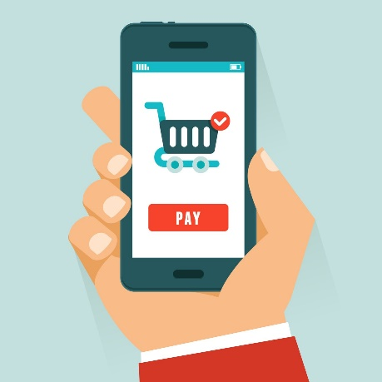
Mobile Payments (Mobile Wallet)
Mobile Payments
  operated under financial regulation and performed from or via a mobile device/cell phone
  Popular mobile payment systems used by businesses include Square, Apple Pay, Google Pay, etc.
  By tapping on an NFC terminal
  (near field communication), mobile phones
  can instantly transfer funds

Slide 11
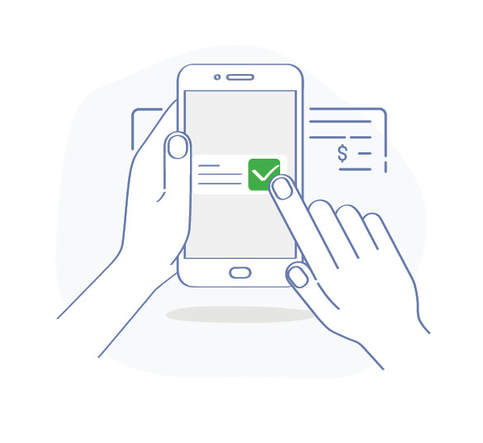
Mobile Check Deposits
Mobile check deposit lets you deposit a check into your bank account by taking a picture of it with your smartphone or tablet
Use your bank’s Mobile App
Endorse (sign) the back of your check and write “For Mobile Deposit Only”
Then take a picture of the front and back of the check

Slide 12
E-Banking Safety
Sign the back of the cards and write
“See ID”
Memorize PIN and keep it hidden
  Do not write it down where the card is kept
  Do not tell others
  Shield the PIN with body at ATMs
  Do not give it out over the phone or e-mail
  Change PIN if it is suspected someone else knows it

Slide 13
E-banking Safety continued
Write down the card number and financial institution contact information
  Store it in a safe place separate from the card in case the card becomes lost or stolen
Report lost or stolen cards to the financial institution immediately.

Slide 14
Overdraft
Overdraft
Consumers have options regarding overdrafts for transactions made with their debit or ATM cards
  An overdraft occurs when a consumer withdrawal from a bank account exceeds the available balance
Consumers may choose to
  Allow an overdraft to occur when using their ATM or debit card
    However, a $20-$30 transaction fee may be applied
  Not allow an overdraft if there is not enough money
    However, their card will be declined
Know your account balance prior to making purchases!

Slide 15
The Future of E-Banking
Consumers like the convenience and 24-hour access to their accounts
Competition in the banking and retail sectors will drive changes to banking in the future.
Will handprint, retina (eye) scan, fingerprint scans or voice commands become popular payment methods in the future? Time will tell.

Slide 16
Happy Trails
Understanding E-Banking and reading about banking and payment methods can help you manage your finances properly and safely!
Any Questions?

