Slide 1
Checking Account & Debit Card Simulation
Understanding Checking Accounts and Debit Card Transactions

Slide 2
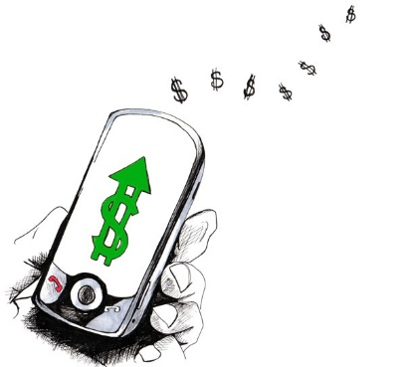
What is a Checking Account?
Common banking tool used by many consumers
Funds are easily accessed
  Check
  Debit card
  ATM (automated teller machine)
  Digital & Electronic Payments
Services and fees vary depending upon the depository institution

Slide 3
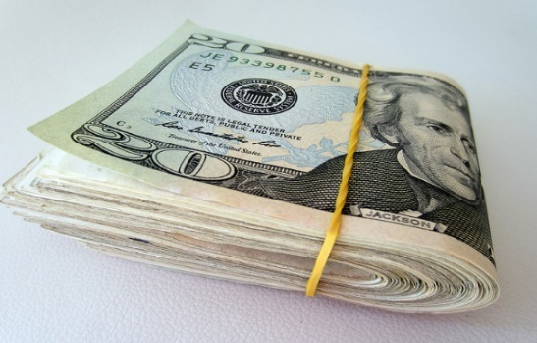
Why Do People Use Checking Accounts?
Reduces the need to carry large amounts of cash
  Close to 50% of Americans carry $20 in cash or less each day. (Source: Wisebread 2016)
Convenience – useful for paying bills
Spending plan tool
  Keeps a record of where money is spent
Safety – using checks and debit cards is safer than carrying cash

Slide 4
Checking Components
Checking Account Register
  Place to immediately record all monetary transactions for a checking account
    Written checks, ATM withdrawals, debit card purchases, deposits, digital payments and additional bank fees
Checkbook
  Contains the checks and the register to track monetary transactions
  *Keeping a record of all your checking transactions can be done in an electronic register or a paper register.

Slide 5
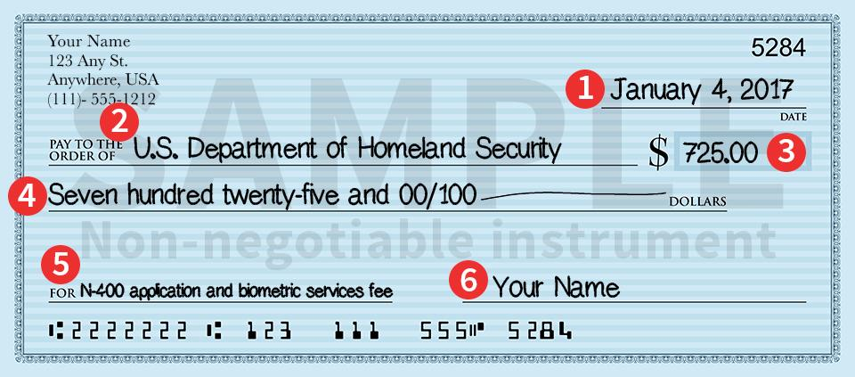
What is a Check?
Legal document that functions like cash
Used at the time of purchase as the form of payment
Piece of paper pre-printed with the account holder’s:
  Name
  Address
  Depository institution’s routing number
  Account identification numbers

Slide 6
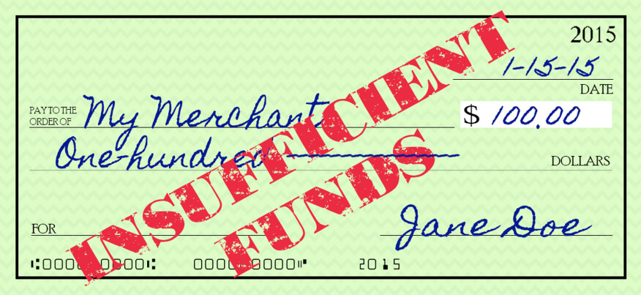
Bouncing a Check
Check written for an amount payable over the current balance held in the account
  The check bounces due to insufficient funds, or not enough money in the account to cover the check written
A fee will be charged to the account holder
The practice of bouncing checks can harm future opportunities for credit
Some banks allow protection from overdrawing your account by connecting savings and checking account

Slide 7
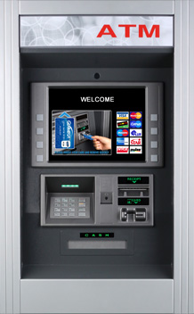
ATM
Automated Teller Machine, can dispense cash
Can also be used to transfer money or make deposits
Additional fees, often known as “foreign transaction fees”, may be assessed if the ATM used is not one provided by the depository institution sponsoring the card

Slide 8
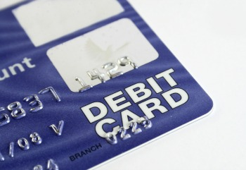
Debit Card
Plastic card that looks like a credit card but is electronically connected to a bank account
Money is automatically taken from the bank account when purchases are made
Requires a PIN (personal identification number)
Confirms the user is authorized to access the account

Slide 9
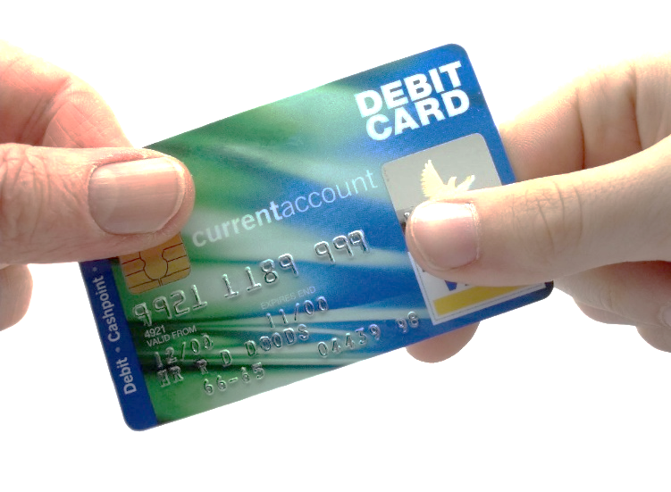
To Use A Debit Card
Swipe or insert card into chip reader in the point-of-sale machine at a store, or put into an ATM
Enter the PIN
Complete the transaction
Some debit cards can be used like credit cards but money is immediately taken from your checking account

Slide 10
Pros and Cons - Debit Cards
Convenient
Small
Allows a person to carry less cash
Does not allow overspending
Can lose track of balance if transactions are not written down
Opens checking account up to possible fraud
Others can gain access to the account if the card is lost and PIN is known

Slide 11
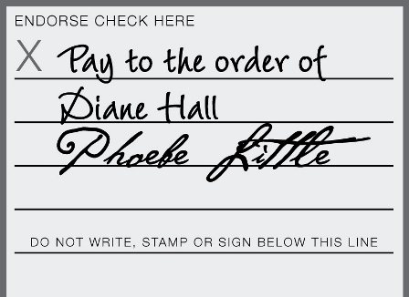
Endorsing a Check
Endorsement
  Signature on the back of a check to give approval for check to be deposited or cashed
  A check should be endorsed to be deposited
Three types of Endorsements
  Blank
  Restrictive
  Special

Slide 12
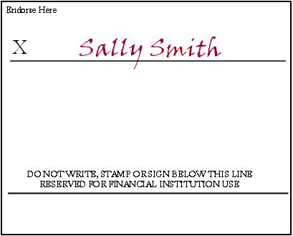
Blank Endorsement
Receiver of the check signs his/her name
Anyone can cash or deposit the check after has been signed

Slide 13
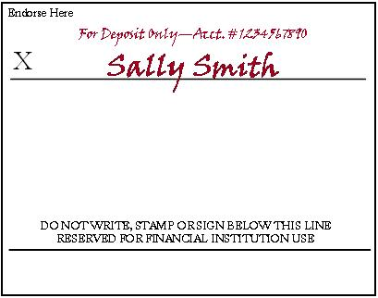
Restrictive Endorsement
More secure than blank endorsement
Receiver writes “for deposit only” and account number above his/her signature
  Allows the check to only be deposited and can’t be cashed

Slide 14
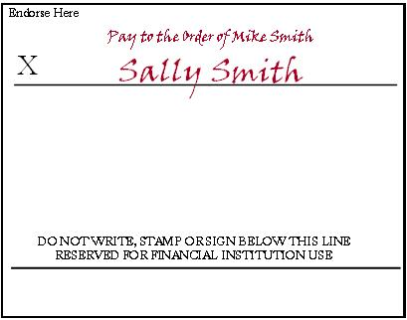
Special Endorsement
Receiver signs and writes “pay to the order of (fill in person’s name)”
Allows the check to be transferred to a second party
  Also known as a two-party check

Slide 15
Worksheet Answers
Blank
Restrictive
Endorse Here
Endorse Here
For Deposit Only—Acct. # 987654321
Student’s Signature
X
Student’s Signature
X
Special
Endorse Here
X
Pay to the Order of Jonathon Smith
Student’s Signature

Slide 16
Making a Deposit
What’s a Deposit Slip?
  Typically a pre-printed slip with the account number. Allows money (cash or check) to be deposited into the correct account
  Located in the back of the checkbook
Complete a deposit slip to make a deposit
Deposited amount must be recorded in the checking account register to keep the balance current
Deposits can be made at an ATM, with a bank teller, or electronically

Slide 17

Completing a Deposit Slip
Deposit Slip
93-456-9540
45086244786
Sally Smith
500 Great Street
Yourtown, MT 55555
CASH | Dollars | Cents
CHECKS List Singly
Total From Other Side
SUBTOTAL
* Less Cash Received
NET DEPOSIT | $
Date
September 1, 2XXX
DEPOSITS MAY NOT BE AVAILABLE FOR IMMEDIATE WITHDRAWAL
SIGN HERE FOR CASH RECEIVED
Guardian Angel Banking
423 South 15th
Yourtown, MT 55555
0123456789 : 1234567890 "
Date
  The date the deposit is being made, including the year
xxxx

Slide 18
Completing a Deposit Slip
Deposit Slip
93-456-9540
45086244786
Sally Smith
500 Great Street
Yourtown, MT 55555
CASH | Dollars | Cents
CHECKS List Singly
Total From Other Side
SUBTOTAL
* Less Cash Received
NET DEPOSIT | $
Date
September 1, 2XXX
DEPOSITS MAY NOT BE AVAILABLE FOR IMMEDIATE WITHDRAWAL
Sally Smith
SIGN HERE FOR CASH RECEIVED
Guardian Angel Banking
423 South 15th
Yourtown, MT 55555
0123456789 : 1234567890 "
Signature Line
  Sign this line to receive cash back

Slide 19
Completing a Deposit Slip
Deposit Slip
93-456-9540
45086244786
Sally Smith
500 Great Street
Yourtown, MT 55555
CASH | Dollars | Cents
CHECKS List Singly
Total From Other Side
SUBTOTAL
* Less Cash Received
NET DEPOSIT | $
Date
September 1, 2XXX
DEPOSITS MAY NOT BE AVAILABLE FOR IMMEDIATE WITHDRAWAL
Sally Smith
SIGN HERE FOR CASH RECEIVED
Guardian Angel Banking
423 South 15th
Yourtown, MT 55555
0123456789 : 1234567890 "
Cash
  The total amount of cash being deposited

Slide 20
Completing a Deposit Slip
Deposit Slip
93-456-9540
45086244786
Sally Smith
500 Great Street
Yourtown, MT 55555
CASH | Dollars | Cents
CHECKS List Singly
Shake Shack #5678 | 154 | 01
Total From Other Side
SUBTOTAL
* Less Cash Received
NET DEPOSIT | $
Date
September 1, 2XXX
DEPOSITS MAY NOT BE AVAILABLE FOR IMMEDIATE WITHDRAWAL
Sally Smith
SIGN HERE FOR CASH RECEIVED
Guardian Angel Banking
423 South 15th
Yourtown, MT 55555
0123456789 : 1234567890 "
Checks
  List each check individually
    Identify each check on the deposit slip by abbreviating the name of the check writer

Slide 21
Completing a Deposit Slip
CHECKS List Singly | Dollars | Cents
1. Fran Smith #601 | 20 | 00
2.
3.
4.
5.
6.
7.
8.
9.
10.
TOTAL Enter on Front | $ 20 | 00
Checks
  If more checks are being deposited than number of spaces on the front, use the back
  List each check individually
  Add the total, enter it on the front

Slide 22
Completing a Deposit Slip
Deposit Slip
93-456-9540
45086244786
Sally Smith
500 Great Street
Yourtown, MT 55555
CASH | Dollars | Cents
CHECKS List Singly
Shake Shack #5678 | 154 | 01
Total From Other Side | 20 | 00
SUBTOTAL
* Less Cash Received
NET DEPOSIT | $
Date
September 1, 2XXX
DEPOSITS MAY NOT BE AVAILABLE FOR IMMEDIATE WITHDRAWAL
Sally Smith
SIGN HERE FOR CASH RECEIVED
Guardian Angel Banking
423 South 15th
Yourtown, MT 55555
0123456789 : 1234567890 "
Total from Other Side
  The total amount from all checks listed on the back

Slide 23
Completing a Deposit Slip
Deposit Slip
93-456-9540
45086244786
Sally Smith
500 Great Street
Yourtown, MT 55555
CASH | Dollars | Cents
CHECKS List Singly
Shake Shack #5678 | 154 | 01
Total From Other Side | 20 | 00
SUBTOTAL | 174 | 01
* Less Cash Received
NET DEPOSIT | $
Date
September 1, 2XXX
DEPOSITS MAY NOT BE AVAILABLE FOR IMMEDIATE WITHDRAWAL
Sally Smith
SIGN HERE FOR CASH RECEIVED
Guardian Angel Banking
423 South 15th
Yourtown, MT 55555
0123456789 : 1234567890 "
Subtotal
  The total amount of cash and checks

Slide 24
Completing a Deposit Slip
Deposit Slip
93-456-9540
45086244786
Sally Smith
500 Great Street
Yourtown, MT 55555
CASH | Dollars | Cents
CHECKS List Singly
Shake Shack #5678 | 154 | 01
Total From Other Side | 20 | 00
SUBTOTAL | 174 | 01
* Less Cash Received | 30 | 00
NET DEPOSIT | $
Date
September 1, 2XXX
DEPOSITS MAY NOT BE AVAILABLE FOR IMMEDIATE WITHDRAWAL
Sally Smith
SIGN HERE FOR CASH RECEIVED
Guardian Angel Banking
423 South 15th
Yourtown, MT 55555
0123456789 : 1234567890 "
Less Cash Received
  The amount of cash back being received
  This amount is not deposited into account

Slide 25
Completing a Deposit Slip
Deposit Slip
93-456-9540
45086244786
Sally Smith
500 Great Street
Yourtown, MT 55555
CASH | Dollars | Cents
CHECKS List Singly
Shake Shack #5678 | 154 | 01
Total From Other Side | 20 | 00
SUBTOTAL | 174 | 01
* Less Cash Received | 30 | 00
NET DEPOSIT | $ 144 | 01
Date
September 1, 2XXX
DEPOSITS MAY NOT BE AVAILABLE FOR IMMEDIATE WITHDRAWAL
Sally Smith
SIGN HERE FOR CASH RECEIVED
Guardian Angel Banking
423 South 15th
Yourtown, MT 55555
0123456789 : 1234567890 "
Net Deposit
  The amount being deposited into the account
  To calculate the amount, subtract the cash received from the subtotal

Slide 26
Worksheet Answers
Deposit Slip
CHECKS List Singly | Dollars | Cents
1. Sarah Lanning #4459 | 86 | 00
2. Sarah Lanning #692 | 15 | 00
3.
4.
5.
6.
7.
8.
9.
10.
TOTAL Enter on Front | $ 101 | 00
93-456-9540
Sally Smith
500 Great Street
Yourtown, MT 55555
CASH | Dollars | Cents
CHECKS List Singly
Lonni James #598 | 50 | 00
Total From Other Side | 101 | 00
SUBTOTAL | 151 | 00
* Less Cash Received | 15 | 00
NET DEPOSIT | $ 136 | 00
Date
September 2, 2XXX
DEPOSITS MAY NOT BE AVAILABLE FOR IMMEDIATE WITHDRAWAL
Sally Smith
SIGN HERE FOR CASH RECEIVED
Guardian Angel Banking
423 South 15th
Yourtown, MT 55555
0123456789 : 1234567890 "
Checking
Account
Number
Bank
Routing
Number

Slide 27
Writing a Check
To pay for items using a checking account
  A check is given as a form of payment
  Must be completed, signed & given to the person or business asking for payment
Pre-printed items on a check
  Name and address of account holder
  Name and address of depository institution
  Check number
  Identification numbers
  (account & routing)

Slide 28

Writing a Check
Sally Smith
500 Great Street
Yourtown, MT 55555
93-456-9540
45086244786
301
Date
Pay to the
Order Of
Dollars
Guardian Angel Banking
423 South 15th
Yourtown, MT 55555
Memo
0123456789 : 1234567890 : 301
Personal Information
  Account holder’s name and address
  May include a phone number, but not required
  DO NOT list a social security number for safety reasons

Slide 29
Writing a Check
Sally Smith
500 Great Street
Yourtown, MT 55555
93-456-9540
45086244786
301
Date
Pay to the
Order Of
Dollars
Guardian Angel Banking
423 South 15th
Yourtown, MT 55555
Memo
0123456789 : 1234567890 : 301
Check number
  Numbers used to identify checks
  Printed chronologically

Slide 30
Writing a Check
Sally Smith
500 Great Street
Yourtown, MT 55555
93-456-9540
45086244786
301
Date
September 2, 2XXX
Pay to the
Order Of
Dollars
Guardian Angel Banking
423 South 15th
Yourtown, MT 55555
Memo
0123456789 : 1234567890 : 301
Date
  The date the check is written
    *Do not post-date a check (put a future date on it)

Slide 31
Writing a Check
Sally Smith
500 Great Street
Yourtown, MT 55555
93-456-9540
45086244786
301
Date
September 2, 2XXX
Pay to the
Order Of
Gas ‘N’ Go
Dollars
Guardian Angel Banking
423 South 15th
Yourtown, MT 55555
Memo
0123456789 : 1234567890 : 301
Pay to the Order of
  The name of the person or business to whom the check is being written

Slide 32
Writing a Check
Sally Smith
500 Great Street
Yourtown, MT 55555
93-456-9540
45086244786
301
Date
September 2, 2XXX
Pay to the
Order Of
Gas ‘N’ Go
$15.⁷⁸
Dollars
Guardian Angel Banking
423 South 15th
Yourtown, MT 55555
Memo
0123456789 : 1234567890 : 301
Amount of the check in numerals
  The amount of the check written numerically in the box
  Write the cents smaller and underline
  Write the numbers directly next the dollar sign to prevent someone else from adding numbers to change the amount

Slide 33
Writing a Check
Sally Smith
500 Great Street
Yourtown, MT 55555
93-456-9540
45086244786
301
Date
September 2, 2XXX
Pay to the
Order Of
Gas ‘N’ Go
$15.⁷⁸
Fifteen and 78/100
Dollars
Guardian Angel Banking
423 South 15th
Yourtown, MT 55555
Memo
0123456789 : 1234567890 : 301
Amount of the check in words
  The amount of the check written in words on the second line
  Start at the far left of the line, write the amount in words, followed by ‘and’, and the amount of cents over 100; draw a line from the end of the words to the word ‘dollars’

Slide 34
Writing a Check
Sally Smith
500 Great Street
Yourtown, MT 55555
93-456-9540
45086244786
301
Date
September 2, 2XXX
Pay to the
Order Of
Gas ‘N’ Go
$15.⁷⁸
Fifteen and 78/100
Dollars
Guardian Angel Banking
423 South 15th
Yourtown, MT 55555
Memo
Gas
0123456789 : 1234567890 : 301
Memo
  Space used to identify the reason for writing a check; optional
  Good place to write information requested by a company when paying a bill, generally the account number

Slide 35
Writing a Check
Sally Smith
500 Great Street
Yourtown, MT 55555
93-456-9540
45086244786
301
Date
September 2, 2XXX
Pay to the
Order Of
Gas ‘N’ Go
$15.⁷⁸
Fifteen and 78/100
Dollars
Guardian Angel Banking
423 South 15th
Yourtown, MT 55555
Memo
Gas
Sally Smith
0123456789 : 1234567890 : 301
Signature
  The account holder’s signature agreeing to the transaction

Slide 36
Writing a Check
Sally Smith
500 Great Street
Yourtown, MT 55555
93-456-9540
45086244786
301
Date
September 2, 2XXX
Pay to the
Order Of
Gas ‘N’ Go
$15.⁷⁸
Fifteen and 78/100
Dollars
Guardian Angel Banking
423 South 15th
Yourtown, MT 55555
Memo
Gas
Sally Smith
0123456789 : 1234567890 : 301
Identification numbers
  First - routing numbers to identify the account’s financial institution
  Second - account number
  Third - check number

Slide 37
Worksheet Answers
Sally Smith
500 Great Street
Yourtown, MT 55555
93-456-9540
45086244786
302
Date
September 3, 2XXX
Pay to the
Order Of
$375.⁰⁰
Aspen Properties
Three hundred, seventy-five dollars and no/100
Dollars
Guardian Angel Banking
Memo
rent
Sally Smith
0123456789 : 1234567890 : 302

Slide 38

Worksheet Answers
Sally Smith
500 Great Street
Yourtown, MT 55555
93-456-9540
45086244786
303
Date
September 6, 2XXX
Pay to the
Order Of
$27.³²
In and Out Burger
Twenty seven dollars and 32/100
Dollars
Guardian Angel Banking
Memo
food
Sally Smith
0123456789 : 1234567890 : 303

Slide 39
Check 21 & Overdrafts
Check clearing for the 21st Century Act (Check 21)
  When a check is written, the money is immediately withdrawn from a bank account
Overdraft protection from a depository institution
  Consumers may choose to allow their depository institution to accept transactions which will exceed their available balance and be charged a $20-$30 transaction fee.
  Or, they may choose to have overdrafts taken from a savings account

Slide 40
Debit Cards
Account number—links all purchases made with the card to a designated bank account
Expiration date—the debit card is valid and may be used until this date
Cardholder’s name—the cardholder’s full name is written out and displayed
Magnetic strip—when the debit card is swiped, the magnetic strip automatically withdraws funds from the cardholder’s account
Chip Card—A microchip is embedded in both debit and credit cards; Chip payments make your transactions more secure when you use your card at merchants with chip-enabled terminals

Slide 41
Debit Cards
Authorized signature—sign in the signature box on the back of the debit card to authorize payments
  Should also write, “see ID” in the signature box
  Ensures the person using the card is authorized to do so
Verification number—this three digit code is located on the back of the card in the signature area
  Help ensure the card is in the cardholder’s possession when making purchases
  Prevents unauthorized use

Slide 42
Checking Account Register
Place to record all monetary transactions for a checking account
    Deposits, checks, ATM use, debit card purchases, additional bank fees
Used to keep a running balance of the account
Remember…Record every transaction!
  This may be done in an electronic spread sheet or your register

Slide 43
Check Register
Date | Number | Description of Transaction | Payment/Debt (-) |  | Deposit/Credit (+) |  | ✓ T | Fee (If Any) | Balance $
9/03 |  |  | $ |  | $ |  |  | $ | $
Date
  The date the check was written or transaction was made

Slide 44
Check Register
Date | Number | Description of Transaction | Payment/Debt (-) |  | Deposit/Credit (+) |  | ✓ T | Fee (If Any) | Balance $
9/03 | 301 |  | $ |  | $ |  |  | $ | $
Number
  The number of the written check; if a debit card or ATM was used, write DC or ATM

Slide 45
Check Register
Date | Number | Description of Transaction | Payment/Debt (-) |  | Deposit/Credit (+) |  | ✓ T | Fee (If Any) | Balance $
9/03 | 301 | Gas ‘N’ Go | $ |  | $ |  |  | $ | $
 |  | Gas
Description of transaction
  The person/business the check was written to or where the debit card was used
  Gray line can be used to write the memo

Slide 46
Check Register
Date | Number | Description of Transaction | Payment/Debt (-) |  | Deposit/Credit (+) |  | ✓ T | Fee (If Any) | Balance $
9/03 | 301 | Gas ‘N’ Go | $ 15 | 78 | $ |  |  | $ | $
 |  | Gas
Payment/debit(-)
  Amount of the transaction
  Deducted from the balance

Slide 47
Check Register
Date | Number | Description of Transaction | Payment/Debt (-) |  | Deposit/Credit (+) |  | ✓ T | Fee (If Any) | Balance $
 |  |  | $ |  | $ 100 | 00 |  | $ | $
Deposit/credit(+)
  Amount of the transaction
  Added to the balance

Slide 48
Check Register
Date | Number | Description of Transaction | Payment/Debt (-) |  | Deposit/Credit (+) |  | ✓ T | Fee (If Any) | Balance $
9/03 | 301 | Gas ‘N’ Go | $ 15 | 78 | $ |  |  | $ | $
 |  | Gas
Place a √ T
  A box used to track whether the check has cleared on the monthly bank statement when reconciling at the end of each month

Slide 49
Check Register
Date | Number | Description of Transaction | Payment/Debt (-) |  | Deposit/Credit (+) |  | ✓ T | Fee (If Any) | Balance $
9/03 | 301 | Gas ‘N’ Go | $ 15 | 78 | $ |  |  | $ | $
 |  | Gas
Fee (if any)
  Any extra fees charged to the account
  Listed on the bank statement

Slide 50
Check Register
Date | Number | Description of Transaction | Payment/Debt (-) |  | Deposit/Credit (+) |  | ✓ T | Fee (If Any) | Balance $275.00
9/01 | DEP | Deposit | $ |  | $ 144 | 01 |  | $ | 144 | 01
 |  | September Paycheck |  |  |  |  |  |  | 419 | 01
Balance
  The running total of the checking account
  Calculated by adding or subtracting each transaction
  Keep this updated

Slide 51
Monthly Bank Statement
Guardian Angel Banking
423 South 15th
Yourtown, MT 55555
Statement For:
Sally Smith
500 Great Street
Yourtown, MT 55555
This Statement Covers: 9/1/XX through 9/30/XX
Checking
Account
#1234567890
Previous Statement Balance on 8/31 $ 275.00
Total Deposits $ 280.01 +
Total Withdrawals $ 463.60 -
New Balance $ 91.41
Deposits and Other Credits
Date Posted Transaction Amount
9/3 Deposit at South 15th Branch $ 144.01
9/5 Deposit at South 15th Branch $ 136.00
Total Deposits $ 280.01
Withdrawals
Date Posted Check # Amount
9/3 301 $ 15.78
9/4 302 $ 375.00
9/7 303 $ 27.32
9/9 Debit Card Food Court Pizzeria $ 3.50
9/16 ATM Cash $ 40.00
9/16 ATM Fee Bank Fee $ 2.00
Total Withdrawals $ 463.60

Slide 52
What Can I see on a Monthly Bank Statement?
Lists each monetary transaction and the current account balance for a specified time period
Include:
  Dates
  Identification for each transaction (number or type, date, amount)
  Transaction amounts for withdrawals and/or deposits
  Interest earned (if applicable)
  Fees or charges (if applicable)

Slide 53
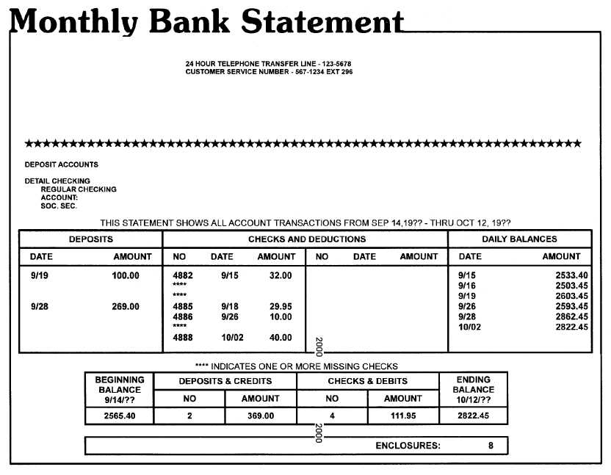
Monthly Bank Statements…
List each transaction and current account balance
  Deposits
  Checks
  Debit card transactions
  ATM transactions
  Pre-arranged automatic
  payments
  Additional fees

Slide 54
Reconciling a Checking Account
Defining the act of “Reconciling”
  Balance the checkbook register each month to the balance shown on the statement
Do this every month to ensure the correct balance in the checkbook
  Knowing the correct balance can help to avoid bouncing checks

Slide 55
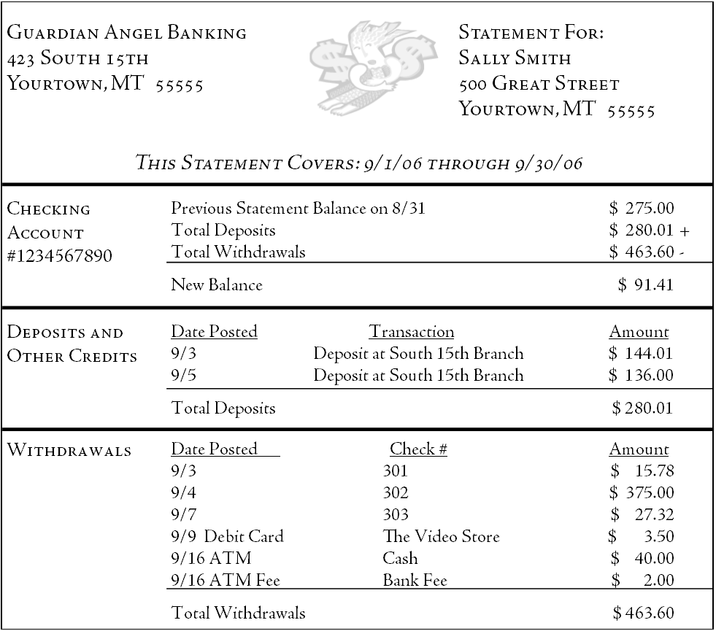
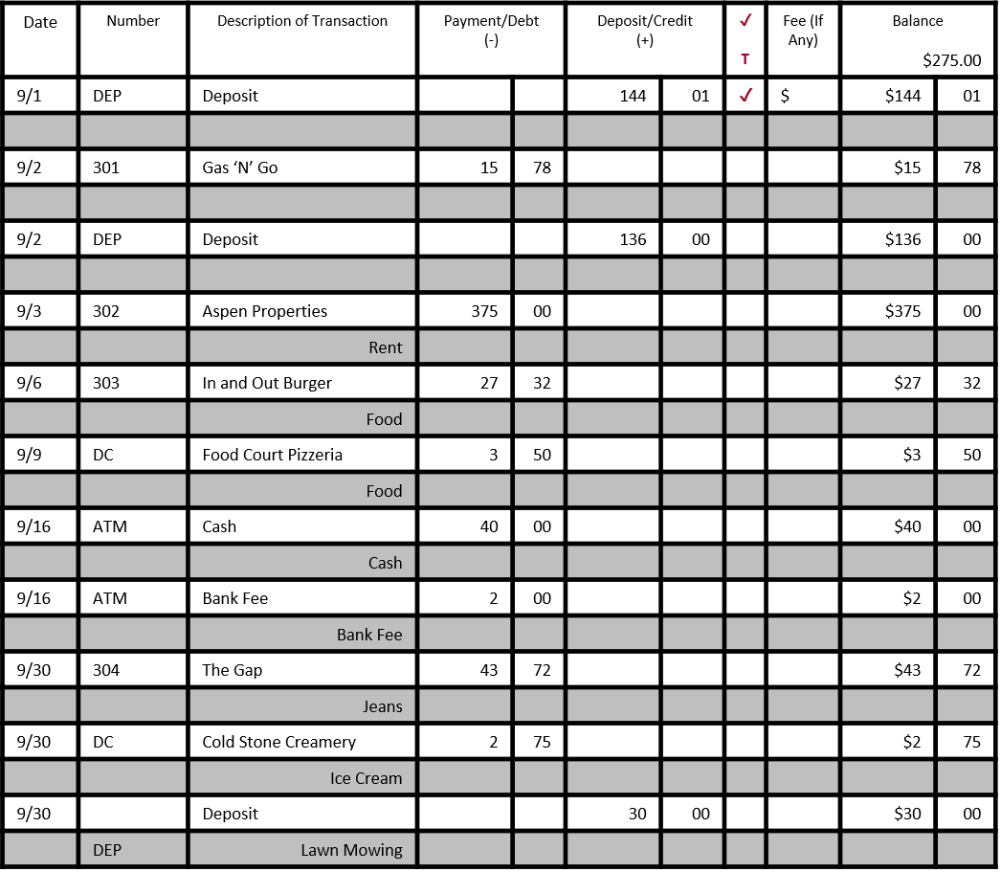

Steps for Reconciling
View your monthly bank statement and check register
xx
xx
Food Court Pizzeria

Slide 56
Place a check mark in the √ T column for all transactions that have been cleared and are shown on the bank statement
Date | Number | Description of Transaction | Payment/Debt (-) |  | Deposit/Credit (+) |  | ✓ T | Fee (If Any) | Balance $275.00
9/1 | DEP | Deposit |  |  | 144 | 01 | ✓ | $ | $144 | 01
9/2 | 301 | Gas ‘N’ Go | 15 | 78 |  |  |  |  | $15 | 78
9/2 | DEP | Deposit |  |  | 136 | 00 |  |  | $136 | 00
9/3 | 302 | Aspen Properties | 375 | 00 |  |  |  |  | $375 | 00
 |  | Rent
9/6 | 303 | In and Out Burger | 27 | 32 |  |  |  |  | $27 | 32
 |  | Food
9/9 | DC | Food Court Pizzeria | 3 | 50 |  |  |  |  | $3 | 50
 |  | Food
9/16 | ATM | Cash | 40 | 00 |  |  |  |  | $40 | 00
 |  | Cash
9/16 | ATM | Bank Fee | 2 | 00 |  |  |  |  | $2 | 00
 |  | Bank Fee
9/30 | 304 | The Gap | 43 | 72 |  |  |  |  | $43 | 72
 |  | Jeans
9/30 | DC | Cold Stone Creamery | 2 | 75 |  |  |  |  | $2 | 75
 |  | Ice Cream
9/30 | DEP | Deposit |  |  | 30 | 00 |  |  | $30 | 00
 |  | Lawn Mowing |  |  |  |  |  |  | $74 | 94
√
√
√
√
√
√
√

Slide 57

Determine the current account balance from the bank statement
Guardian Angel Banking
423 South 15th
Yourtown, MT 55555
Statement For:
Sally Smith
500 Great Street
Yourtown, MT 55555
This Statement Covers: 9/1/XX through 9/30/XX
Checking
Account
#1234567890
Previous Statement Balance on 8/31 $ 275.00
Total Deposits $ 280.01 +
Total Withdrawals $ 463.60 -
New Balance $ 91.41
Deposits and Other Credits
Date Posted Transaction Amount
9/3 Deposit at South 15th Branch $ 144.01
9/5 Deposit at South 15th Branch $ 136.00
Total Deposits $ 280.01
Withdrawals
Date Posted Check # Amount
9/3 301 $ 15.78
9/4 302 $ 375.00
9/7 303 $ 27.32
9/9 Debit Card Food Court Pizzeria $ 3.50
9/16 ATM Cash $ 40.00
9/16 ATM Fee Bank Fee $ 2.00
Total Withdrawals $ 463.60

Slide 58
Add any outstanding deposits – transactions that have not cleared the bank
Calculate the Subtotal
Deposits Outstanding
Date | Amount
9/30 | 30 | 00
Total | 30 | 00
ENTER Bank Statement Balance | $ 91.41
ADD (+) Outstanding Deposits | $ 30.00
SUBTOTAL (=) | $ 121.41
SUBTRACT (-) Outstanding Withdrawals | $ D
CALCULATE (=) Total should be the same as the checkbook register | $ E

Slide 59
Subtract any outstanding withdrawals and calculate
ENTER Bank Statement Balance | $ 91.41
ADD (+) Outstanding Deposits | $ 30.00
SUBTOTAL (=) | $ 121.41
SUBTRACT (-) Outstanding Withdrawals | $ 46.47
CALCULATE (=) Total should be the same as the checkbook register | $ 74.94
  Compare the total with the checkbook register. If the totals are different, double check the math and make sure all service fees and bank charges are recorded in the check register.

Slide 60
Checking Account Safety
If a checkbook, ATM, and/or debit card becomes lost or stolen
  Immediately report it to the depository institution
  File a report with the police
Reported lost/stolen checkbook:
  Depository institutions generally do not hold the account holder liable for any fraudulent charges

Slide 61
Safety continued
Report lost/stolen ATM/debit card:
  Within 2 business days
    Cardholder is only liable for $50.00
  Report longer than 2 business days
    Could be liable for up to $500.00
  Varies depending upon the depository institution
    May not charge the account holder anything if the correct steps were taken to report the lost/stolen card

Slide 62
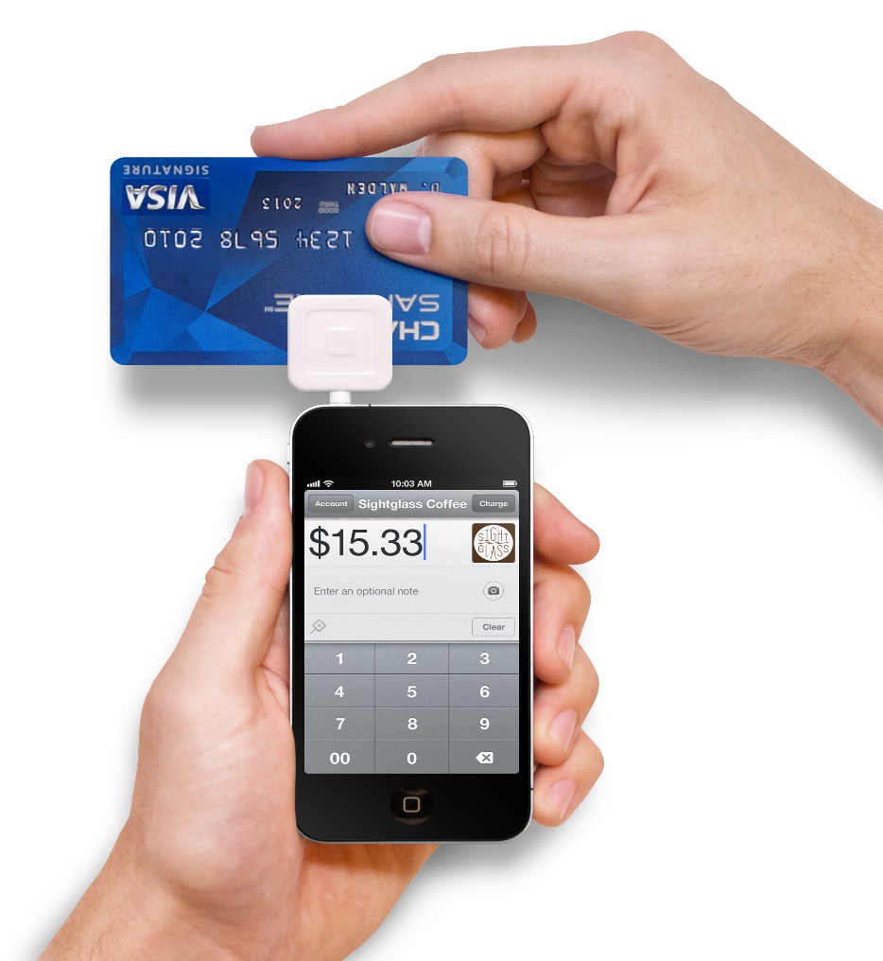
Making Mobile Payments
Apple Pay
Google Pay
Square Cash
PayPal
Venmo

Slide 63
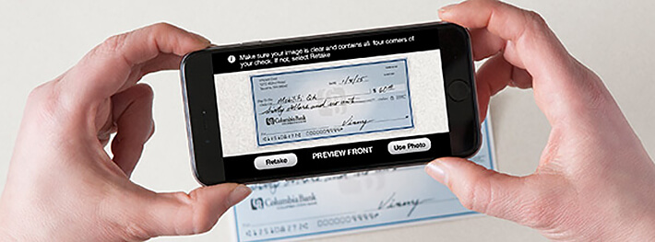
Mobile Deposits
Sign up for Mobile Banking with your depository institution
Take a picture of a check with your phone
Take a picture of your endorsement on the back of your check to finalize your deposit

Slide 64
Questions?

